Slide 1
Proton->IOTA Update
Eric Prebys
June 15, 2015

Slide 2
Fermilab Accelerator Science and Technology
New name: The FAST Facility (Fermilab Accelerator Science and Technology Facility) would encompass what is presently in the New Muon Lab Building and its recently constructed extension. It will have:
The IOTA ring (an experimental storage ring for electrons and protons)
An electron injector (a 300-MeV SRF-based photo injector)
A proton injector (a 2.5-MeV conventional ion source followed by an RFQ)
All associated conventional, rf and cryo infrastructure, presently housed at the New Muon Lab and its extension.

Slide 3
Planned Milestones
FY15 | 20 MeV e- commissioned HE beam line 40% IOTA parts 60%
FY16 | 50 MeV e- commissioned 150 MeV CM2 to dump IOTA installed 60%
FY17 | IOTA installed IOTA e- commissioned IOTA research starts with e- Proton RFQ move 30%
FY18 | Proton RFQ move 100% Proton RFQ commissioned
FY19 | IOTA research starts with p+

Slide 4
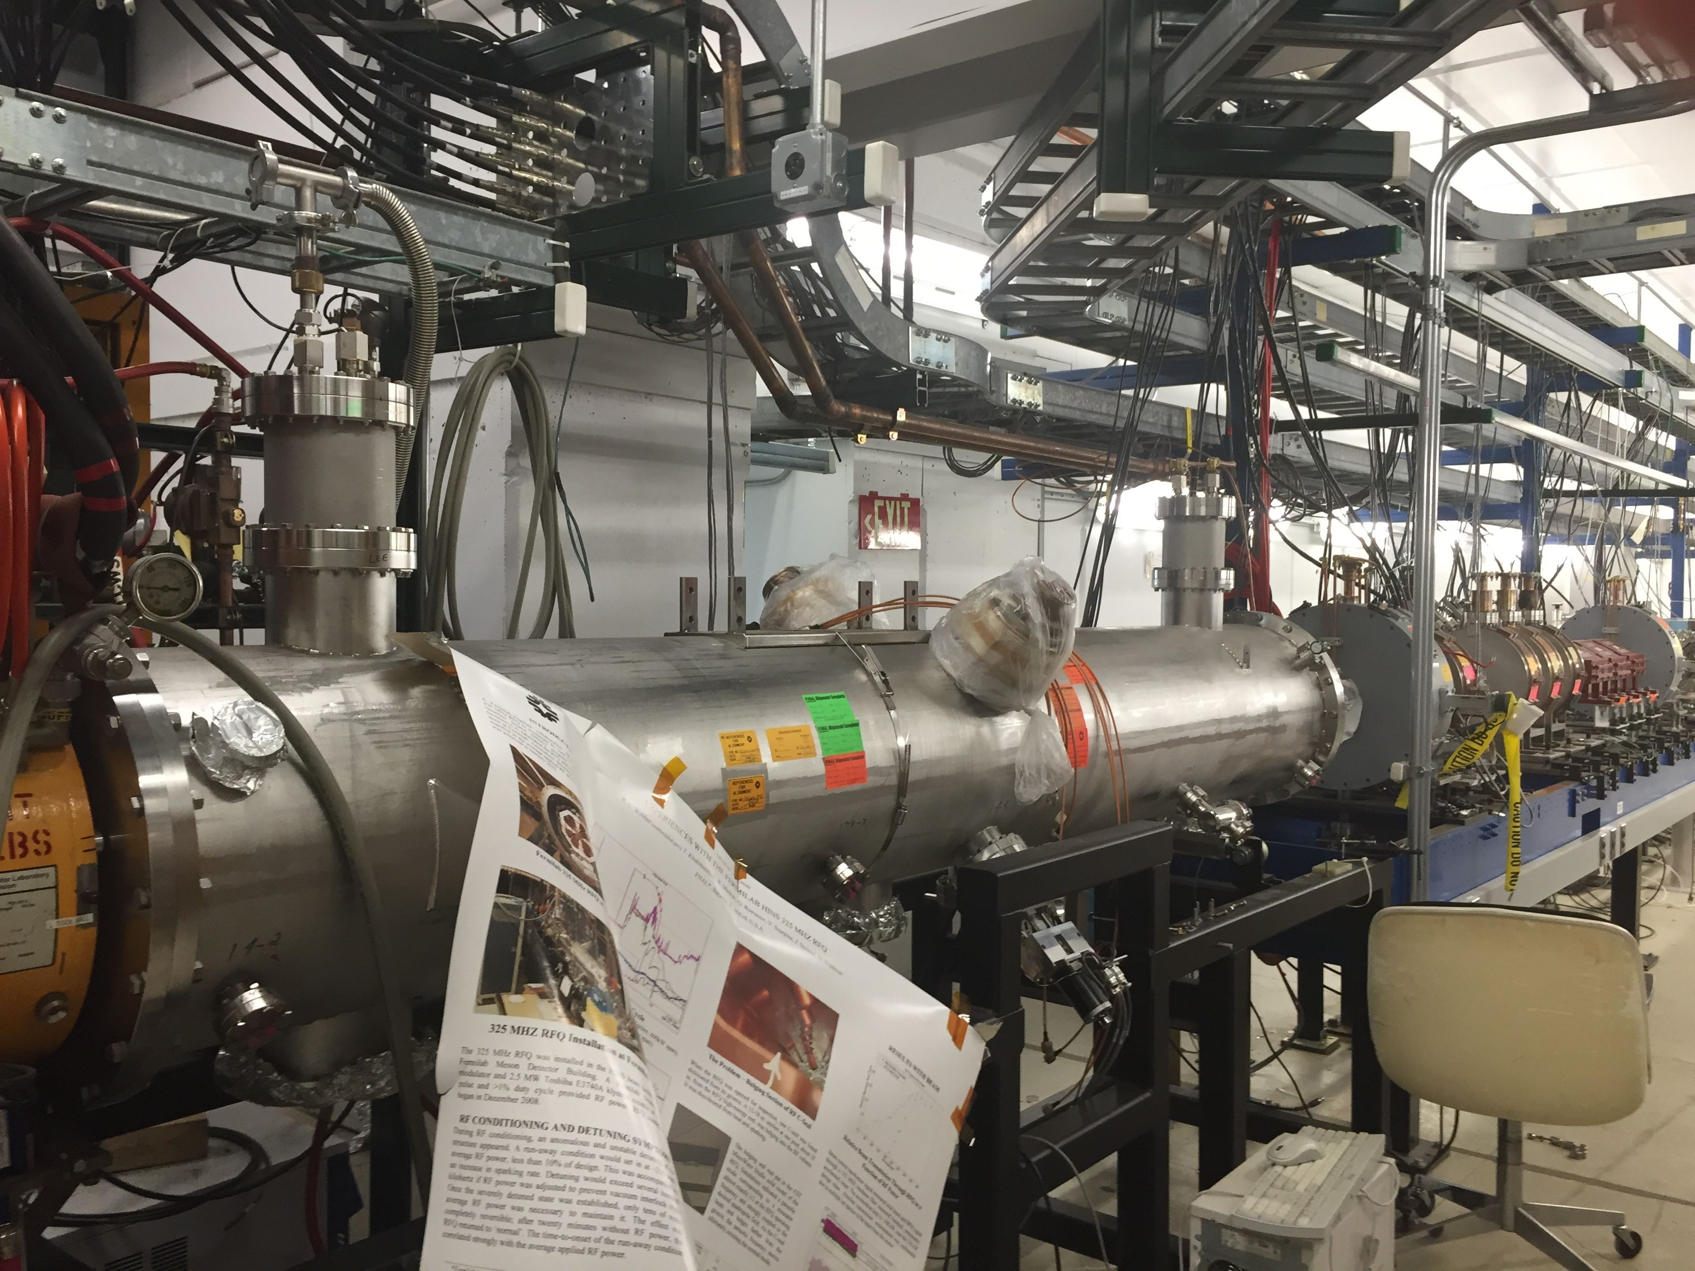
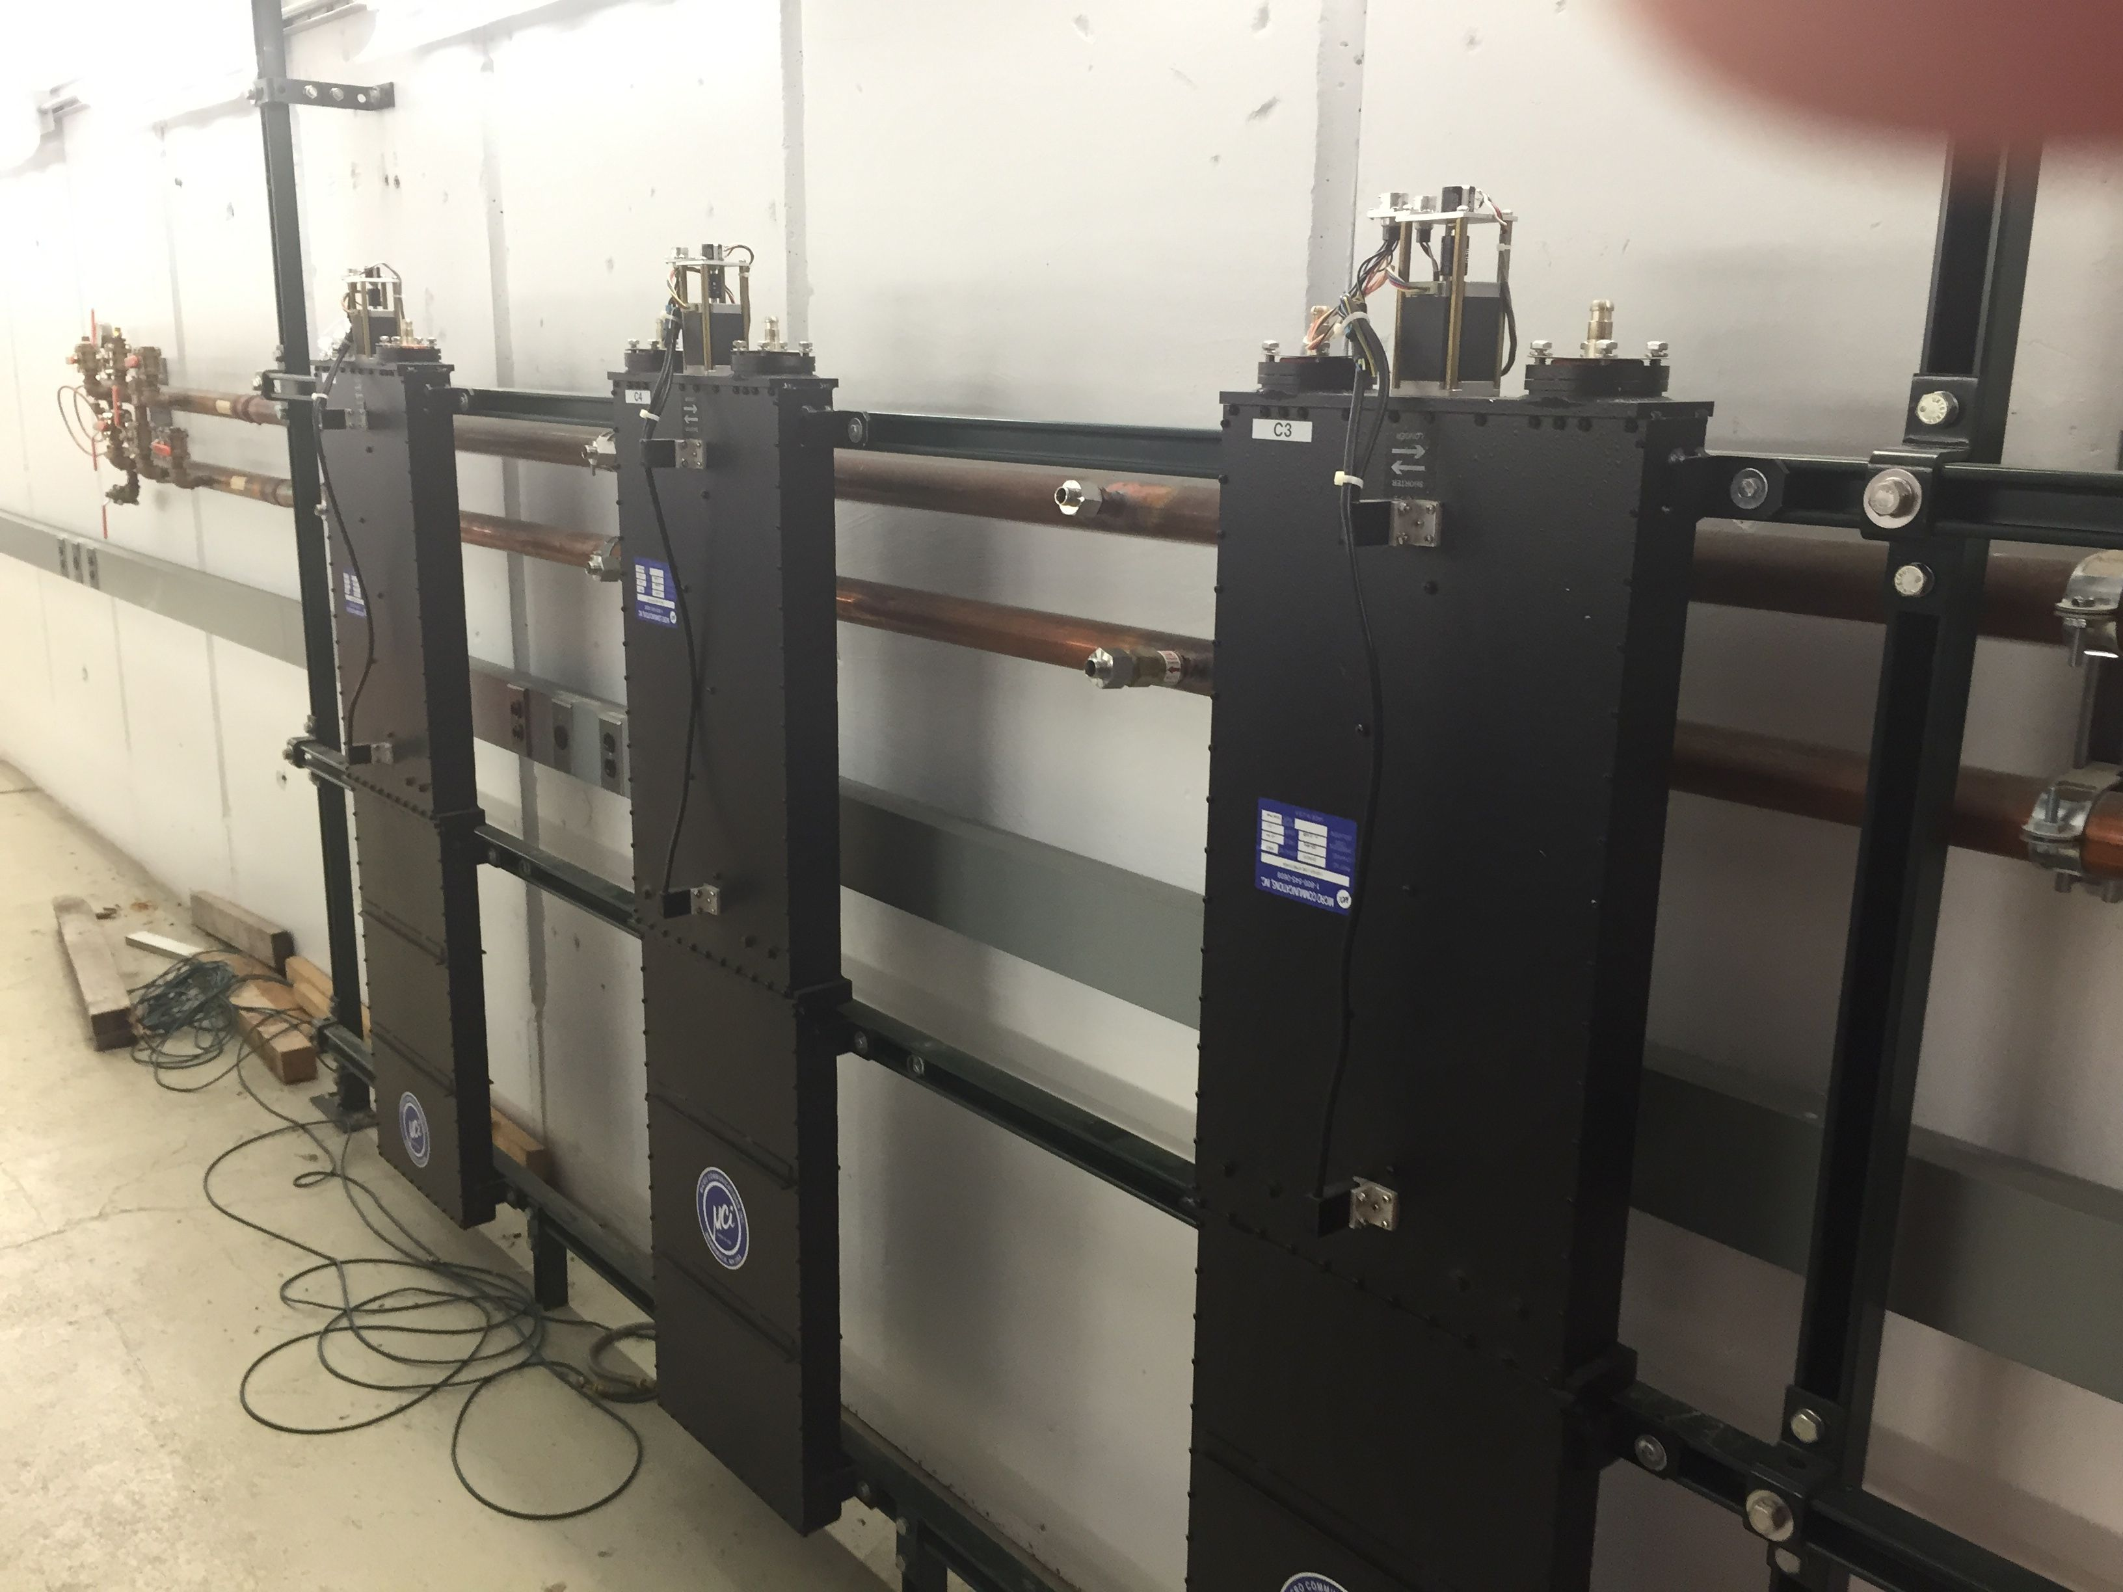
Issues: lots of entropy at HINS
The major pieces still exist, but everything’s been disconnected since HINS last ran ~5 years ago.

Slide 5
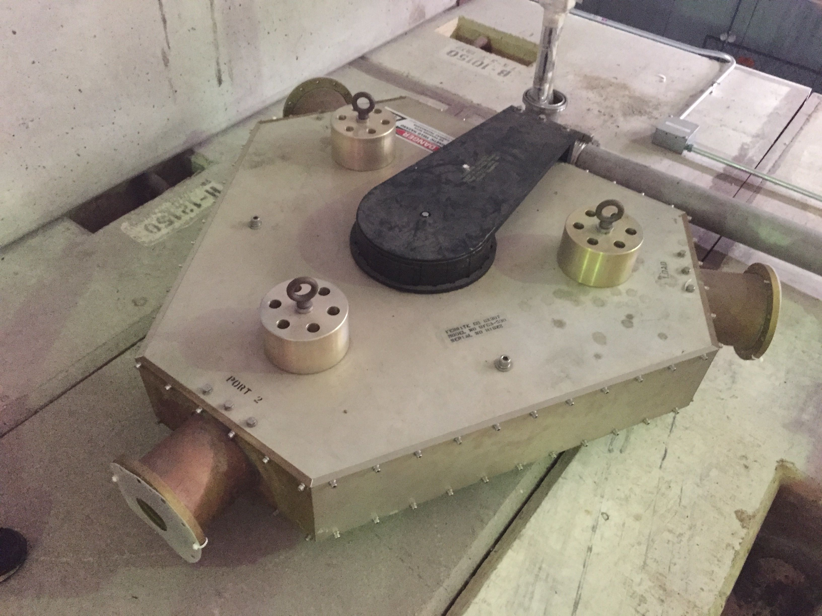
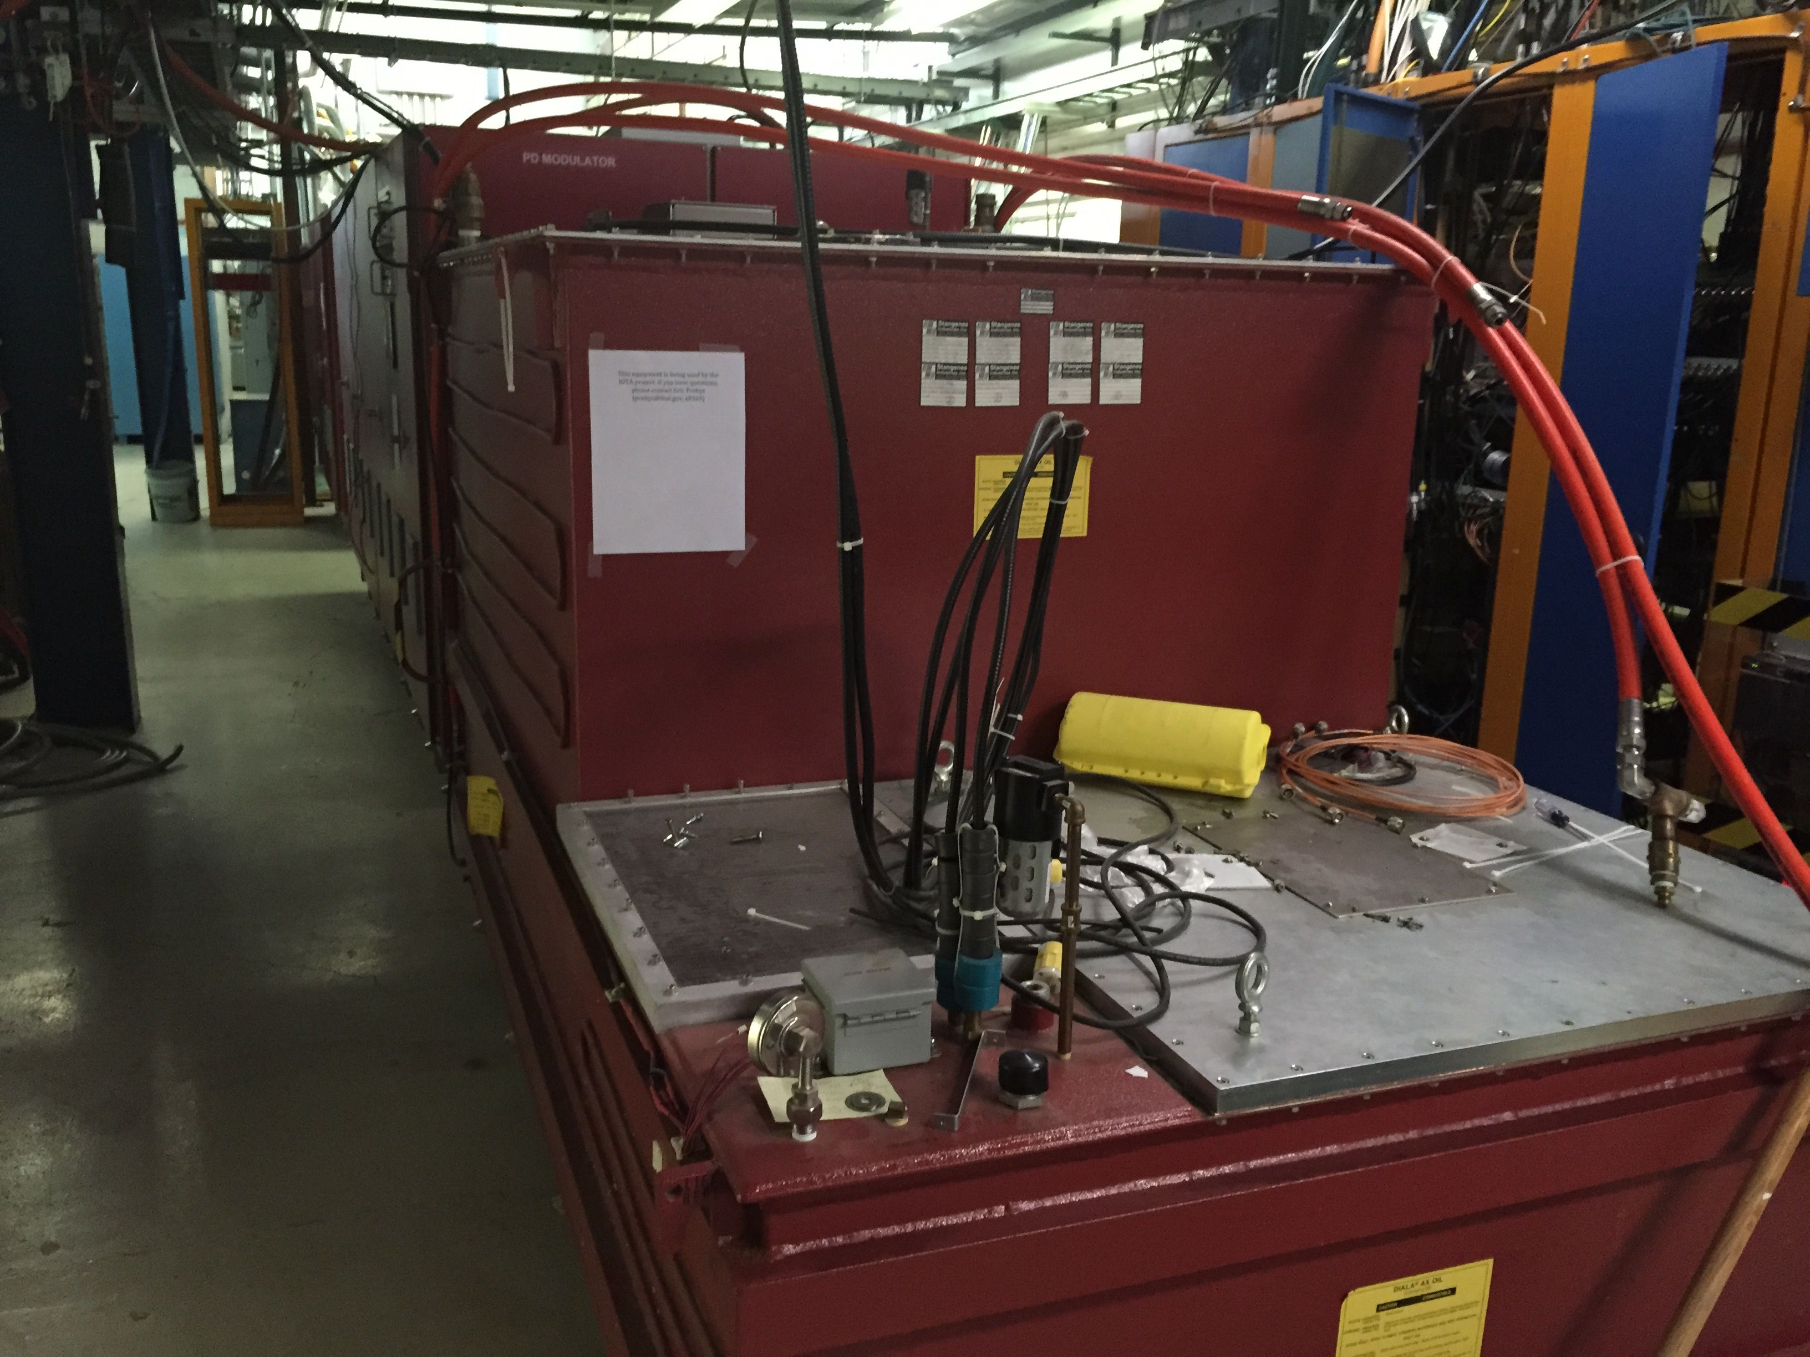
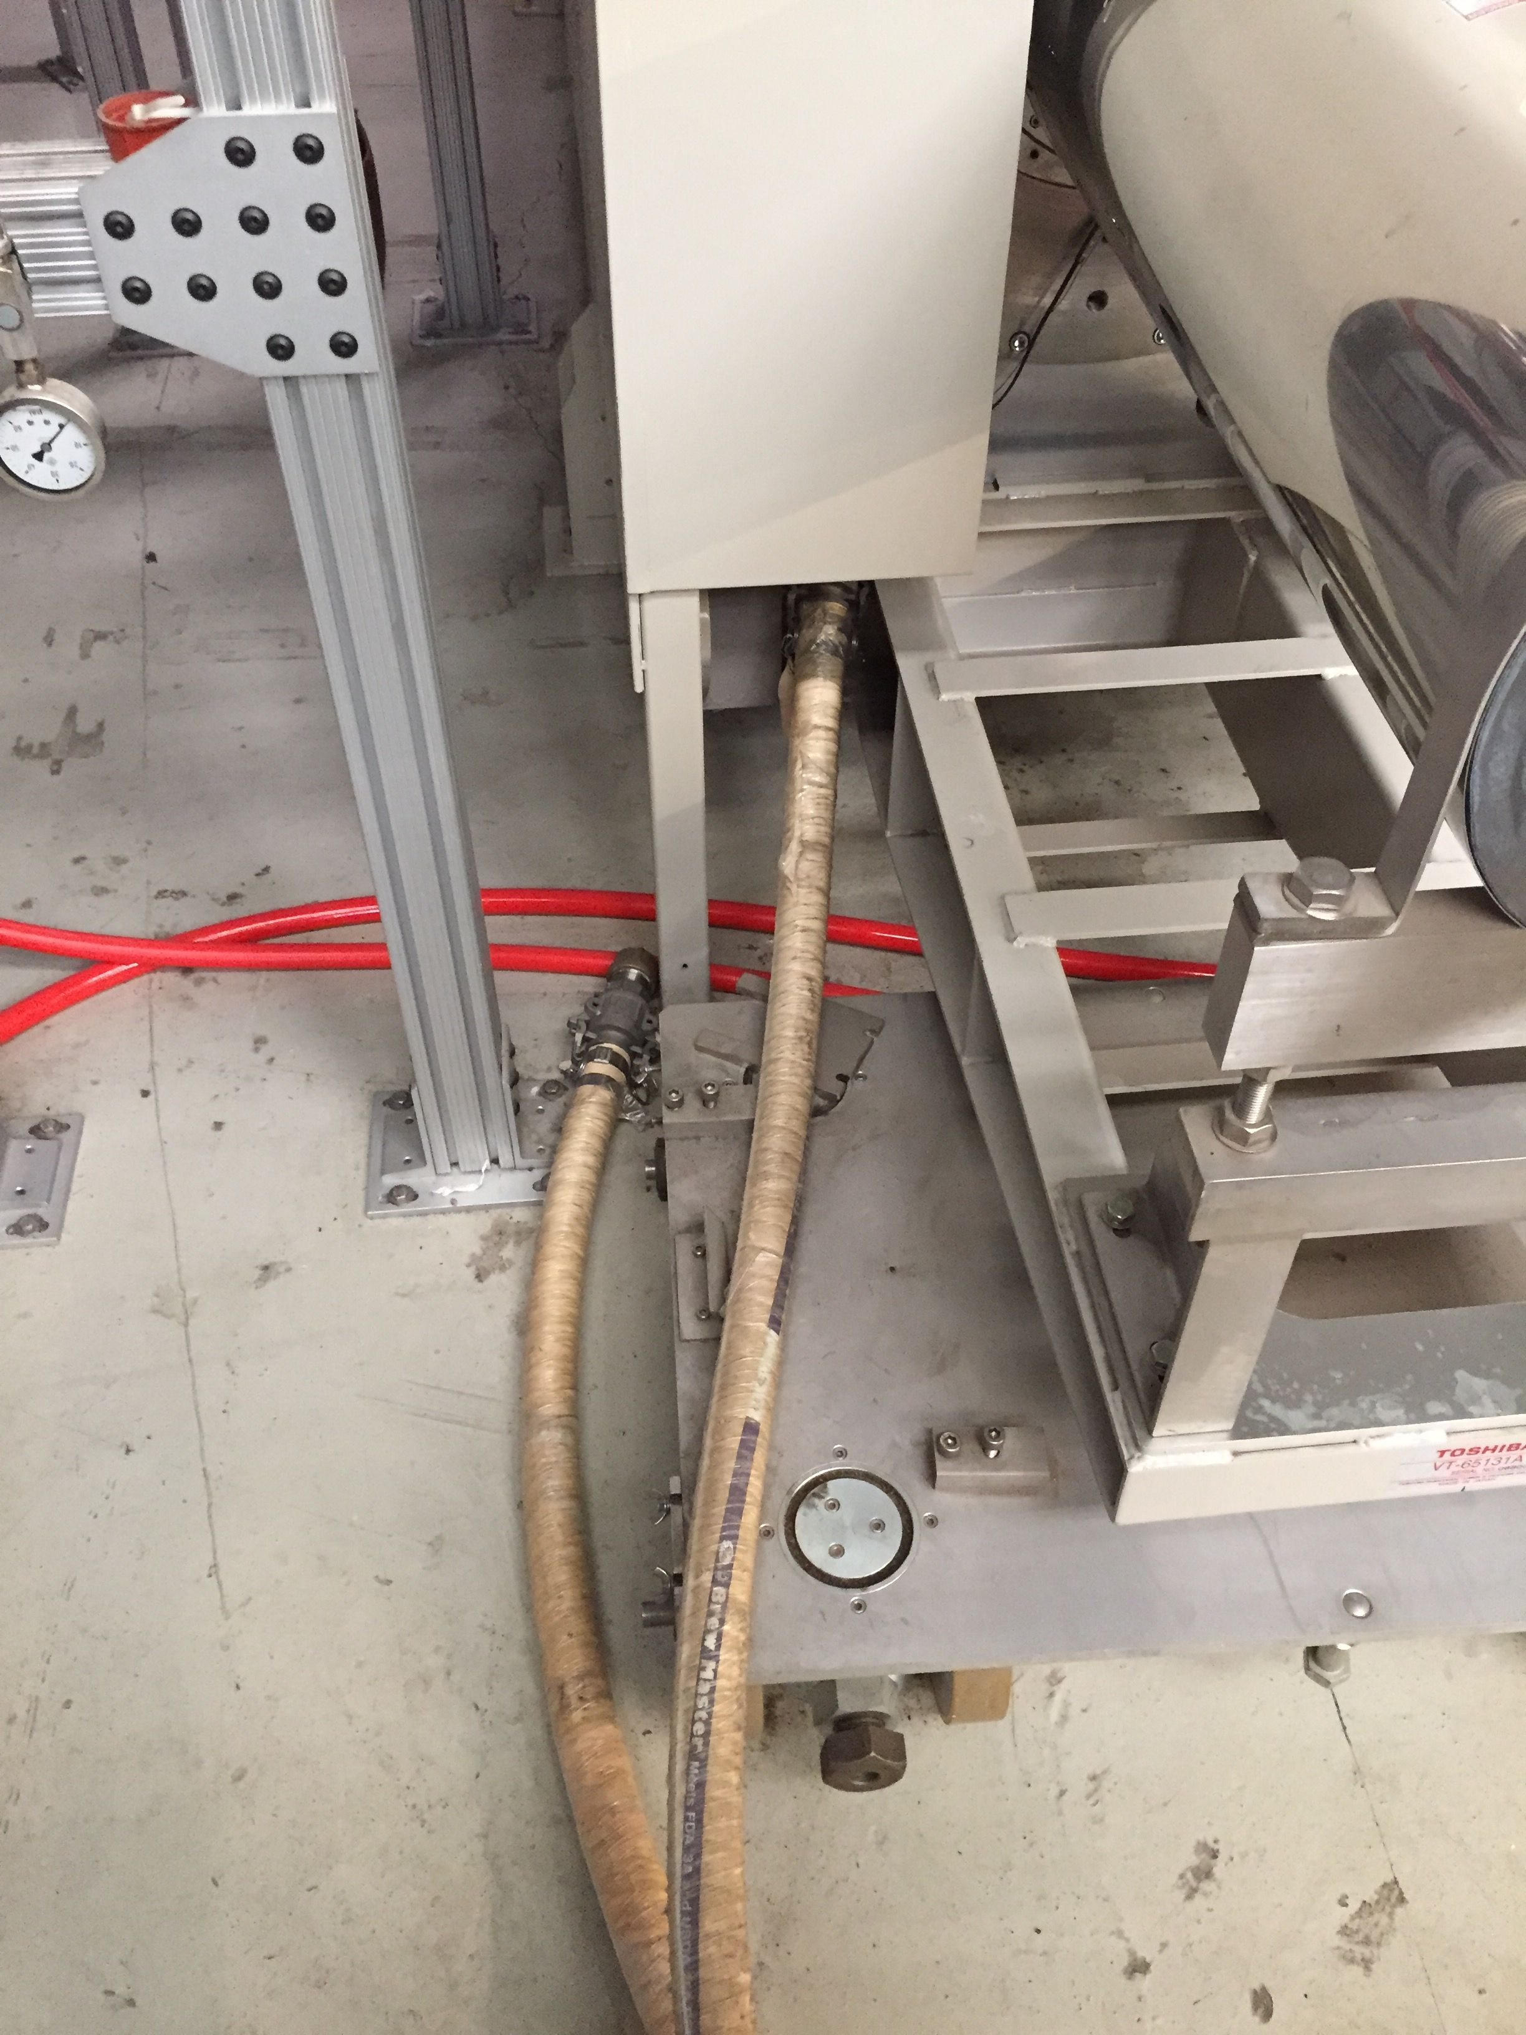
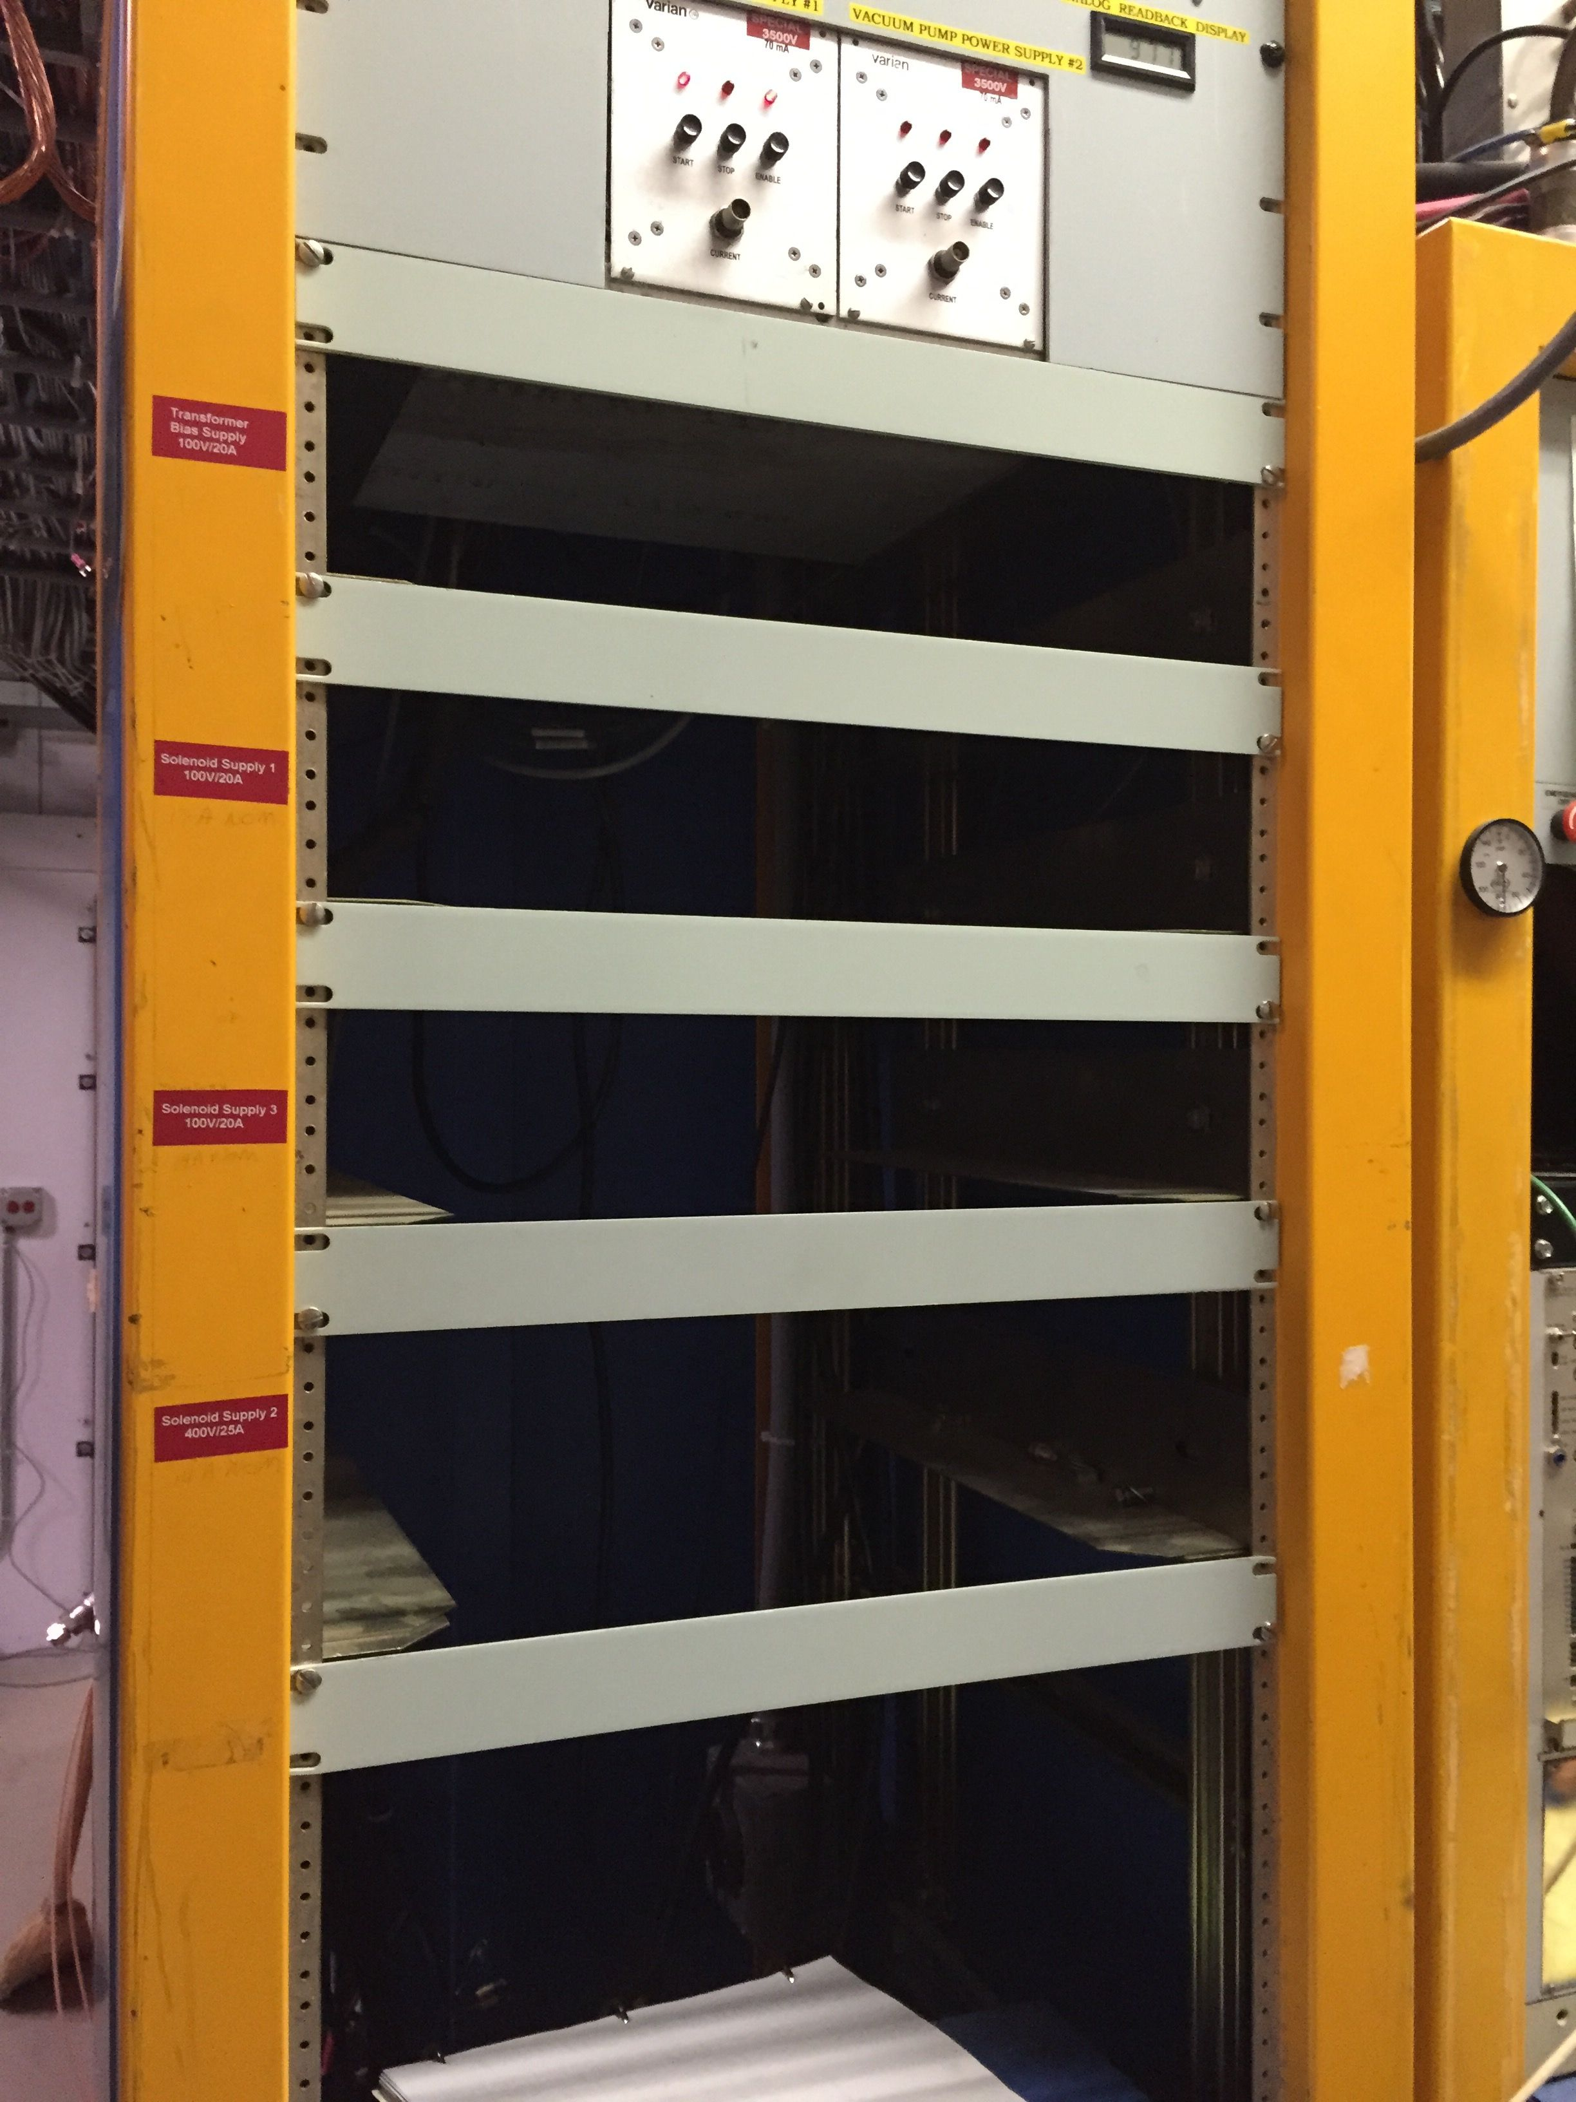
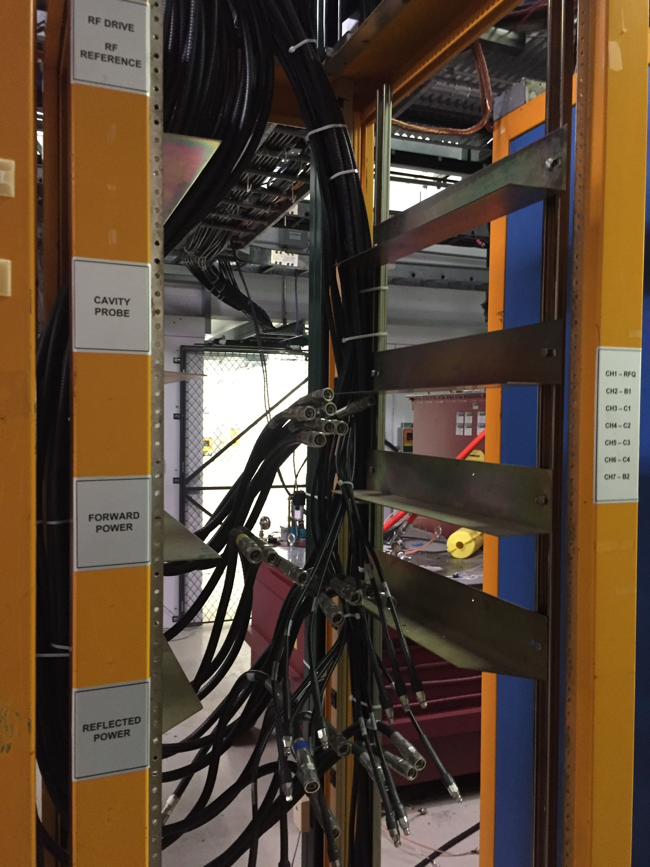
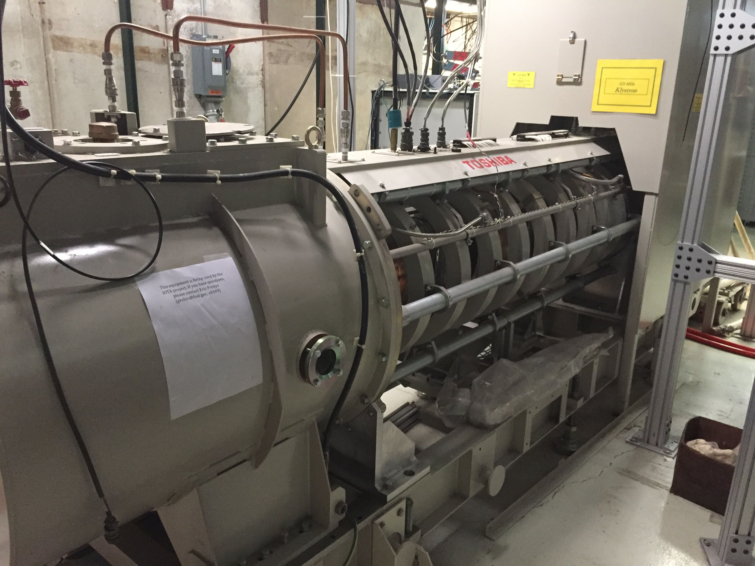
Entropy: cont’d

Slide 6
General Plan
Stabilize Area
locks on cave
signs on equipment, messages to other groups: “not parts bin”
Get RFQ working in current location (HINS cave at MDB)
FY15:
Get ion source under vacuum and activate filament
FY16:
Establish 50kV beam from ION source
Resurrect 325MHz klystron, reconnect it, and establish 2.5 MeV Beam in situ
Establish proton beam at IOTA
FY17:
Move ion source, RFQ and girder to IOTA
Use new 325 MHz klystron (in storage)
Use charging supply, modulator and transformer that were intended for the third ASTA cryomodule (at FAST)

